Slide 1
B.Tech – CSE – Sem. 3 18CSS201J – ANALOG AND DIGITAL ELECTRONICS (Regulations 2018)
UNIT 4- Session-1
Introduction to Sequential circuits, Latch and Flip-Flops

Slide 2
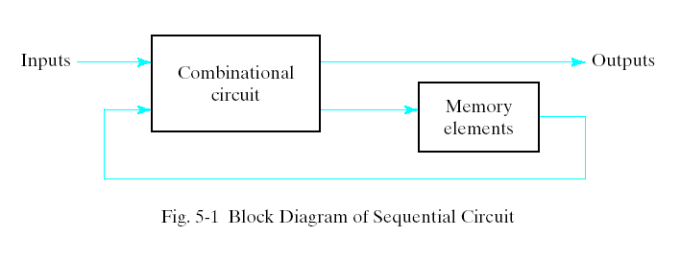
Sequential Circuits
Every digital system is likely to have combinational circuits, most systems encountered in practice also include storage elements, which require that the system be described in term of sequential logic.

Slide 3
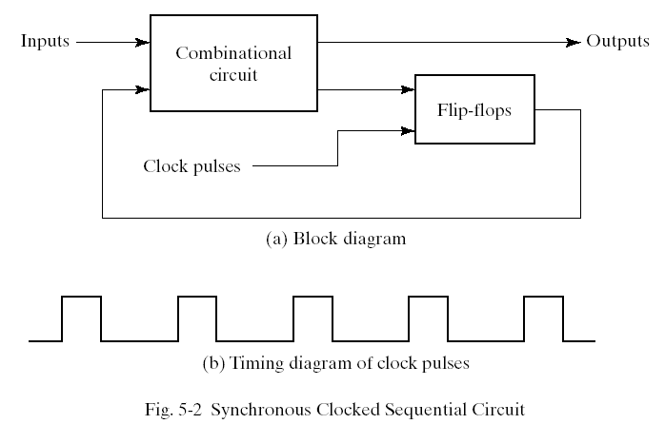
Synchronous Clocked Sequential Circuit
A sequential circuit may use many flip-flops to store as many bits as necessary. The outputs can come either from the combinational circuit or from the flip-flops or both.

Slide 4
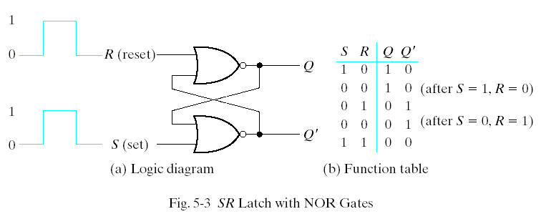
Latches --SR Latch
The SR latch is a circuit with two cross-coupled NOR gates or two cross-coupled NAND gates. It has two inputs labeled S for set and R for reset.

Slide 5
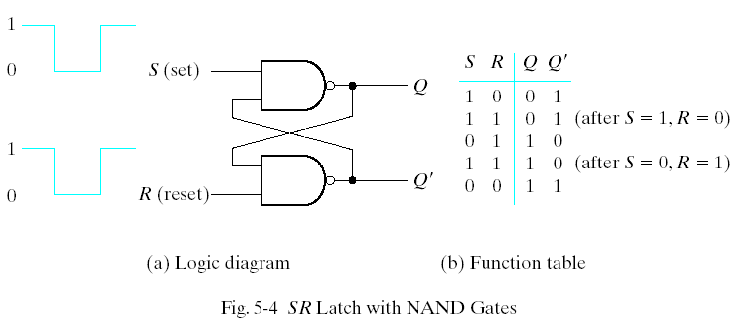
SR Latch with NAND Gates

Slide 6
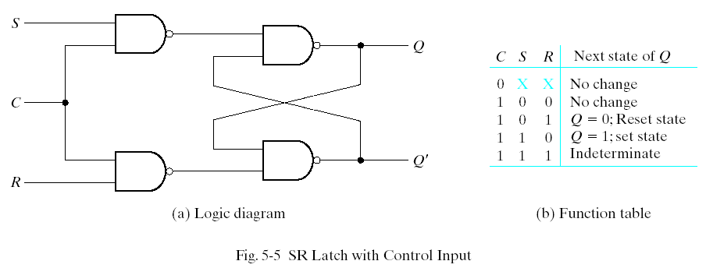
SR Latch with Control Input
The operation of the basic SR latch can be modified by providing an additional control input that determines when the state of the latch can be changed. In Fig. 5-5, it consists of the basic SR latch and two additional NAND gates.

Slide 7
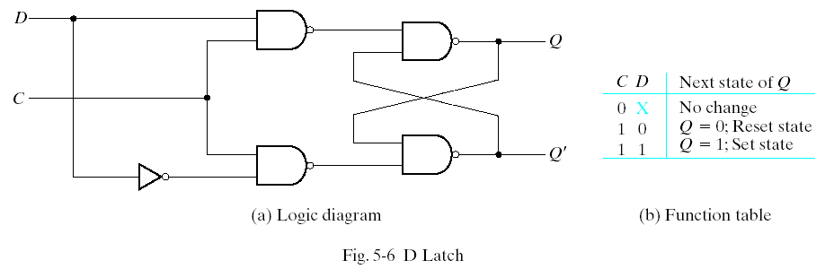
D Latch
One way to eliminate the undesirable condition of the indeterminate state in SR latch is to ensure that inputs S and R are never equal to 1 at the same time in Fig 5-5. This is done in the D latch.

Slide 8
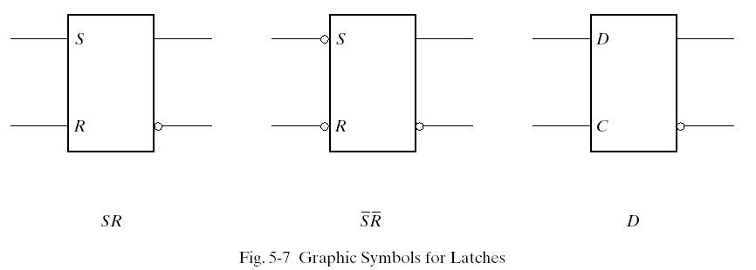
Graphic Symbols for latches
A latch is designated by a rectangular block with inputs on the left and outputs on the right. One output designates the normal output, and the other designates the complement output.

Slide 9
Flip-Flops
The state of a latch or flip-flop is switched by a change in the control input. This momentary change is called a trigger and the transition it cause is said to trigger the flip-flop. The D latch with pulses in its control input is essentially a flip-flop that is triggered every time the pulse goes to the logic 1 level. As long as the pulse input remains in the level, any changes in the data input will change the output and the state of the latch.

Slide 10
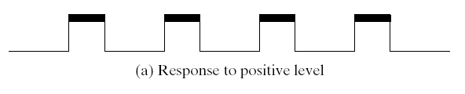
Clock Response in Latch
In Fig (a) a positive level response in the control input allows changes, in the output when the D input changes while the clock pulse stays at logic 1.

Slide 11
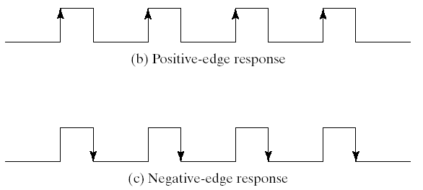
Clock Response in Flip-Flop

Slide 12
S-R Flip Flop
The SET-RESET flip flop is designed with the help of two NOR gates and also two NAND gates. These flip flops are also called S-R Latch.
S-R Flip Flop using NOR Gate The design of such a flip flop includes two inputs, called the SET [S] and RESET [R].
There are also two outputs, Q and Q’.

Slide 13
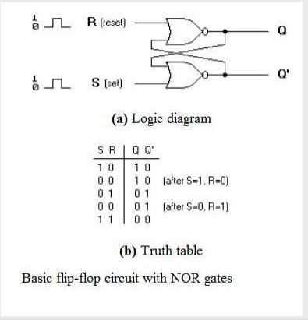

Slide 14
From the diagram it is evident that the flip flop has mainly four states. They are S=1, R=0—Q=1, Q’=0 This state is also called the SET state.
S=0, R=1—Q=0, Q’=1 This state is known as the RESET state. In both the states you can see that the outputs are just compliments of each other and that the value of Q follows the value of S.
S=0, R=0—Q & Q’ = Remember If both the values of S and R are switched to 0, then the circuit remembers the value of S and R in their previous state.
S=1, R=1—Q=0, Q’=0 [Invalid] This is an invalid state because the values of both Q and Q’ are 0. They are supposed to be compliments of each other. Normally, this state must be avoided.

Slide 15
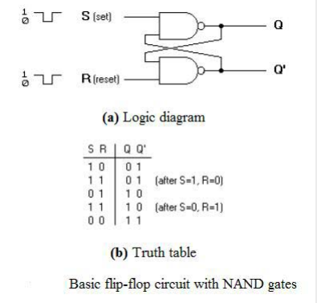
S-R Flip Flop using NAND Gate

Slide 16
Like the NOR Gate S-R flip flop, this one also has four states. They are S=1, R=0—Q=0, Q’=1 This state is also called the SET state.
S=0, R=1—Q=1, Q’=0 This state is known as the RESET state. In both the states you can see that the outputs are just compliments of each other and that the value of Q follows the compliment value of S.
S=0, R=0—Q=1, & Q’ =1 [Invalid] If both the values of S and R are switched to 0 it is an invalid state because the values of both Q and Q’ are 1. They are supposed to be compliments of each other. Normally, this state must be avoided.
S=1, R=1—Q & Q’= Remember If both the values of S and R are switched to 1, then the circuit remembers the value of S and R in their previous state.

